Slide 1
Where to live: Exploring the Coolest Neighbourhoods in Toronto Ramesh Baskaran November 30, 2020
IBM Data Science Capstone Project

Slide 2
1.0 Introduction
Toronto is the second fastest growing urban centre in North America.
Toronto is Canada’s technology hub.
New immigrants and job seekers are moving into the city yearly.
Living in Toronto depends on your preferences and lifestyle.

Slide 3
2.0 Objective of the Study
Find the safest and coolest neighbourhoods to live or relocate in Toronto.
This study will take into account crime, apartment rentals, population density, and amenities surrounding the neighbourhoods.

Slide 4
3.0 Target Audience
Prospective property buyers and tenants who are looking to buy a property at a location.
Local and global business investors.
Real estate investment prospects for local and non-resident investors.
Toronto City Councils.
New immigrants and job seekers from out of state.

Slide 5
4.0 Data Collection
4.1 Sources of Data on Toronto Neighbourhoods and Venues Categories
List of Postal Code from Canada: M
Toronto City Government Open Data
Geospatial data
Foursquare API

Slide 6
4.0 Data Collection(cont.)
4.2 Sources of Data for Crime
Toronto Police Service Public Safety Data Portal
GeoJSON
4.3 Sources of Data for Apartment Rental
Kaggle

Slide 7
5.0 Methodology
Strategy based on the mapping of the data from Section 4.
There are four maps to be constructed as follows:
Choropleth Heat Map of Total Crime
Circle Marker Map of Apartment Rental
Circle Marker Map of Clustered Neighbourhood
Consolidate Map of the Toronto Neighbourhood

Slide 8
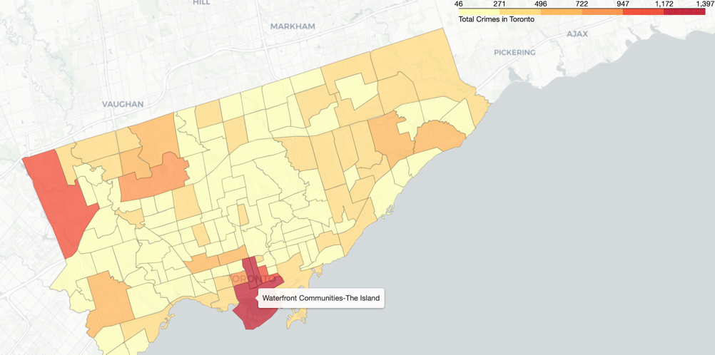
5.0 Results and Discussion
5.1 Results
5.1.1 Choropleth Heat Map of Total Crime

Slide 9
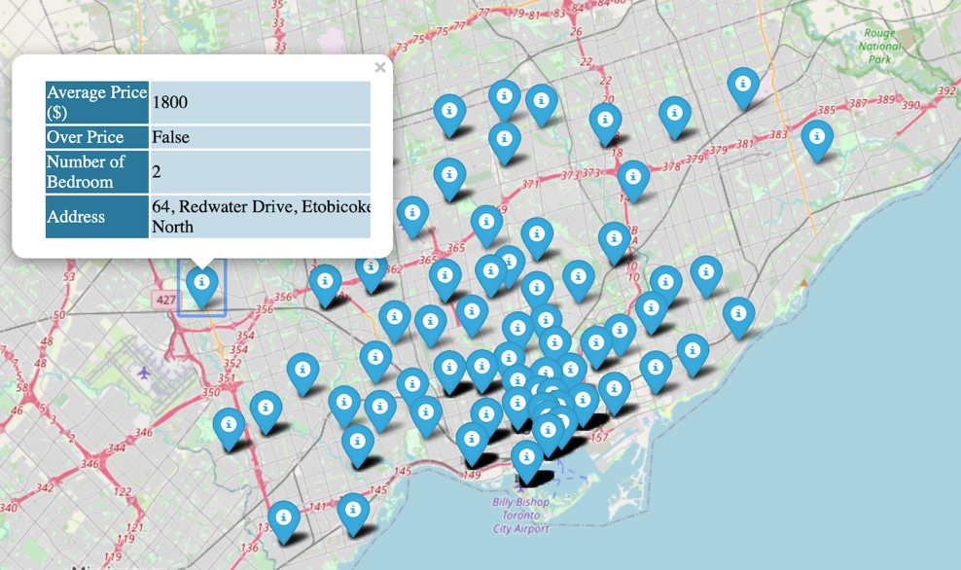
5.0 Results and Discussion(cont.)
5.1.2 Circle Marker Map of Apartment Rental

Slide 10
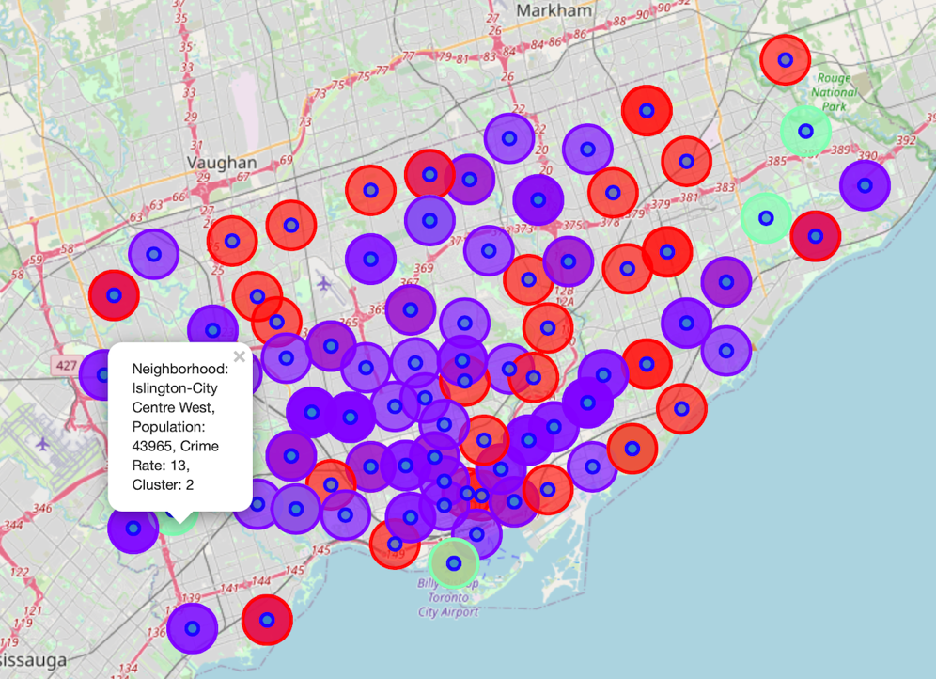
5.0 Results and Discussion(cont.)
5.1.3 Circle Marker Map of Clustered Neighbourhood

Slide 11
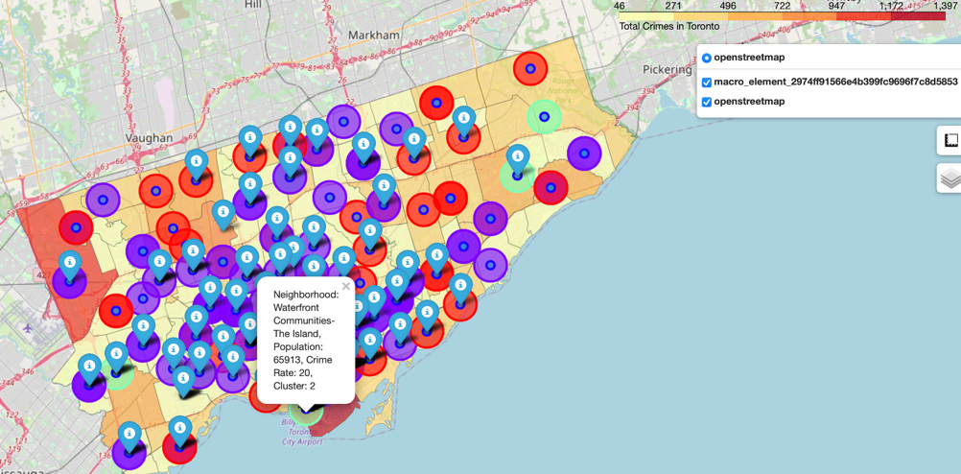
5.0 Results and Discussion(cont.)
5.1.4 Consolidate Map of the Toronto Neighbourhood

Slide 12
5.0 Results and Discussion(cont.)
5.2 Discussion
The number in the parentheses shows the frequencies of the items.
Table 1: Summary of Clusters

Slide 13
5.0 Results and Discussion(cont.)
5.2 Discussion(cont.)
Majority of neighbourhoods in Cluster 2, followed by Cluster 1.
Cluster 3 has only 7 neighbourhoods and widely spread out .
Clusters 1 & 2 clustered close together.
As a result, Clusters 1 and 2 tend to have same common categories as Parks, Coffee Shops, Women Stores, Dumpling Restaurants, Dog Run, and Sandwich or Bakery shops.

Slide 14
5.0 Results and Discussion(cont.)
5.2 Discussion(cont.)
Cluster 3 is less frequented by Women Stores, Dim Sum Restaurants, Pubs, and Dog Run.
In other words, less social activities in Cluster 3 neighbourhoods.
Evidently, there are distinct variations in lifestyle and neighbourhood characteristics between Cluster 3 and other clusters.
Cluster 3 also has the highest population density.

Slide 15
5.0 Results and Discussion(cont.)
5.2 Discussion(cont.)
The following letter codes are used to indicate the reliability of the estimates: a - Excellent, b- Very good,
c - Good, d - Fair (Use with Caution).
** Data suppressed to protect confidentiality or data not statistically reliable.
Table 2: Neighbourhoods with Lowest Crime Rate

Slide 16
5.0 Results and Discussion(cont.)
5.2 Discussion(cont.)
Lambton Baby Point and Yonge-St. Clair are the best neighbourhoods to live in Toronto.
I find that the neighbourhoods listed in Table 3 are the safest and coolest places to live in or move to.
Statistics have been obtained from the Neighbourhood Guide.
Table 3: Top Safest Neighbourhoods in Toronto

Slide 17
6.0 Conclusion
Project objective was to identify which neighbourhoods in Toronto are the safest and coolest places to live in.
Guildwood, Woodbine-Lumsden, Lambton Baby Point, Markland Wood, Old East York, and Yonge-St. Clair are the best neighbourhoods to live in with the lowest crime rates and well-rated amenities.
Lambton Baby Point and Yonge-St. Clair are the top two best neighbourhoods to live in Toronto subject to affordability.

Slide 18
6.0 Conclusion(cont.)
Stakeholders will make their own decision based on preferences and lifestyles, and the unique characteristics of locations.
This project will aid stakeholders narrowing their quest for the best residential neighbourhoods.

